Slide 1
PHYSICAL THEATRE
Year 8 Drama
Lesson 7
Assessment

Slide 2
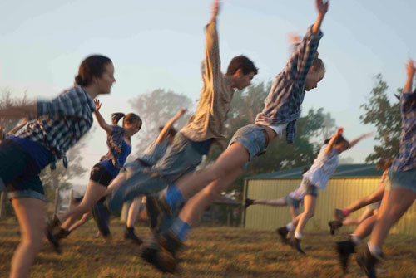
LESSON OBJECTIVE:
To Evaluate your progress and use of physical theatre techniques.

Slide 3
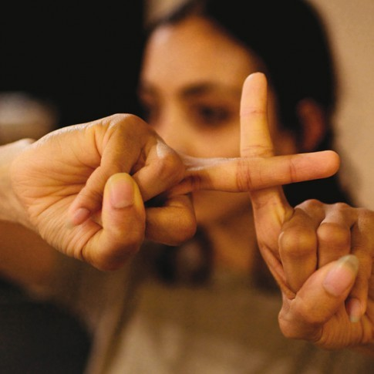
TASK
Lesson Objective:
To Evaluate your progress and use of physical theatre techniques.
In today's lesson you will watch back all your performances and evaluate your work and the work of others.

Slide 4
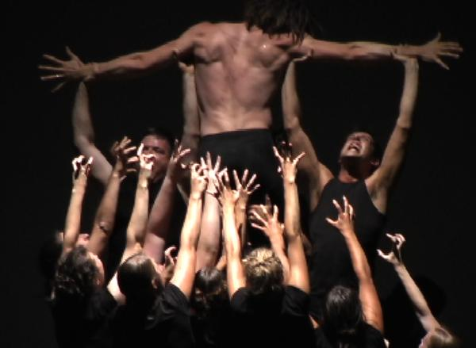
EVALUATION
Lesson Objective:
To Evaluate your progress and use of physical theatre techniques.
Students complete an evaluation sheet, recognising the skills that themselves and others have used in their performance piece.

